Slide 1
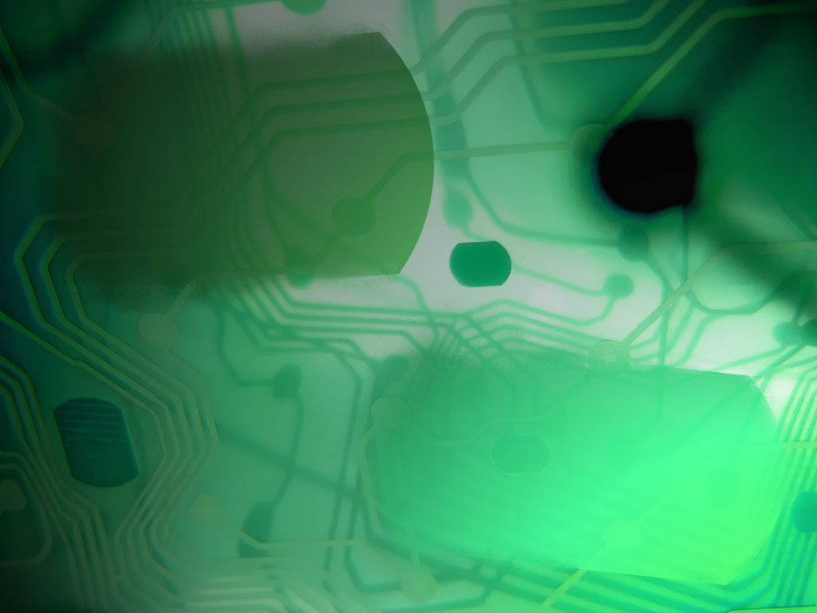
Computer Systems Fundamentals
H175 34
Lecture 6
Computer I/O

Slide 2
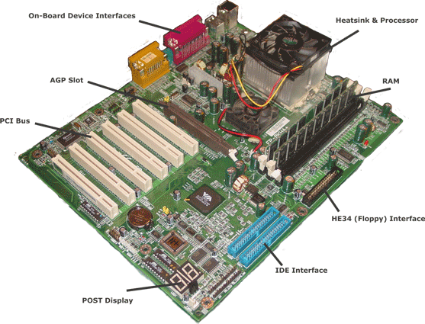
Input/Output Devices
Motherboards included ports that enabled the user to easily add peripherals to the system.
Peripherals allow the user to interact with the computer.
Today, we will look at how these peripherals actually communicate with the CPU – there are two main methods.

Slide 3
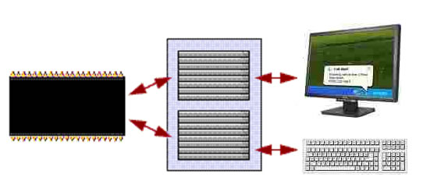
Memory Mapped I/O
The first method treats I/O devices as another type of memory.
The devices have addresses assigned to them and data is sent to, and read from, them exactly in the same was as RAM.
This scheme is called Memory Mapped I/O.

Slide 4
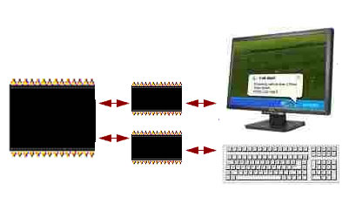
Dedicated I/O
The second scheme uses dedicated I/O commands to transfer data. Often the peripherals will have their own little processors attached to handle these commands.
When these instructions are issued the control bus will signal that the transfer is to a peripheral and not memory.
This scheme is called Dedicated I/O.

Slide 5
Interfaces
I/O interfaces typically contain at least the following elements:
Buffer space to allow the data being transferred to be stored until the hardware is ready to process it
A control bit to start and stop transfers
A flag to signal when transfers are complete

Slide 6
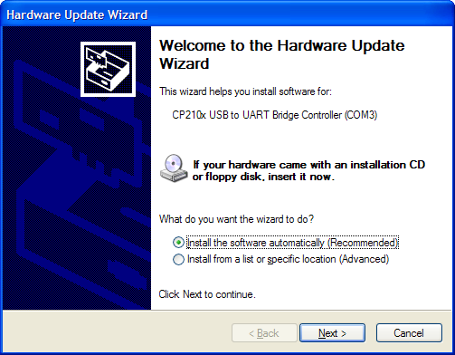
Device Drivers
Hardware usually comes with a dedicated piece of software that enables it to communicate with the operating system. These Device Drivers also pass data to and from the peripheral.

Slide 7

Modern computers require the processor to handle input and output from multiple devices.
But if more than one device requires attention at any given time, how does the processor know which device has priority?

Slide 8
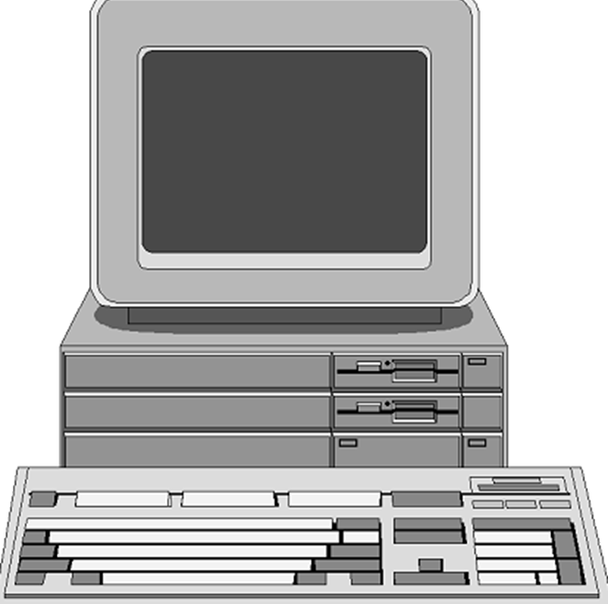
Processors handle multiple devices by one of two mechanisms –
Polling
Interrupting
Each approach has advantages and disadvantages.

Slide 9
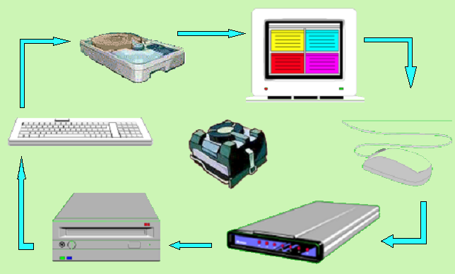
On older systems without many peripherals,
a polling approach would be used.
The processor goes round each device in turn, querying whether there are any resources required.

Slide 10
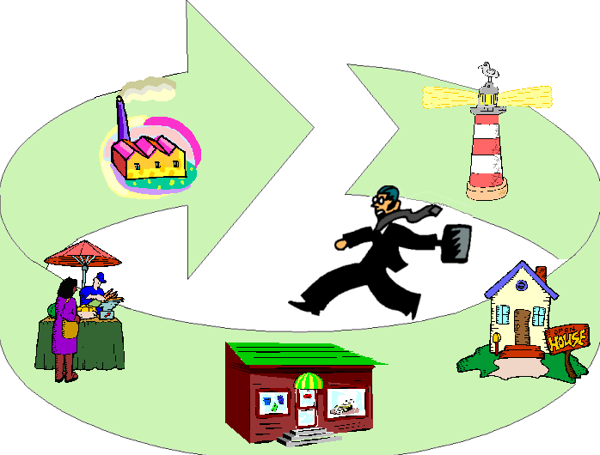
This is equivalent to a salesperson with a fixed customer base. He or she will visit each of the customers in turn, asking whether they need anything.
The advantage of this is that it is a very simple system to implement.

Slide 11
The disadvantage, of course, is that once the salesperson has left, the customer has to wait until he is due to come round again!
The customers needs are not always met timeously! This is also very wasteful of available resources.
With the advance of processor and RAM speeds, polling is seldom used in modern systems.

Slide 12
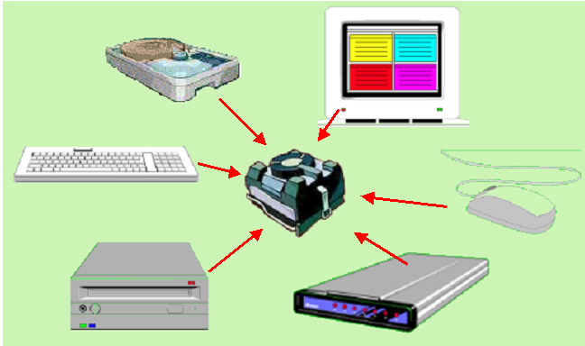
Most modern systems use an Interrupt mechanism.
With interrupting, the focus of the handling has changed. Instead of the device waiting for a query from the processor, it goes to the processor and interrupts it.
The big advantage of this is speed. Devices can have their requirements met much more quickly.

Slide 13
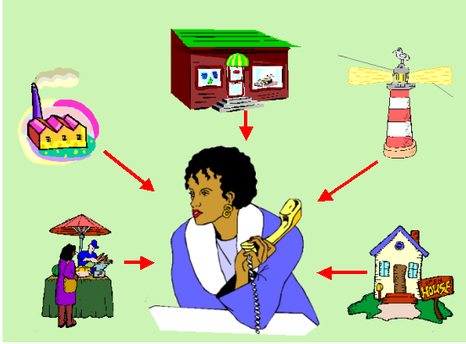
This approach equates to the salesperson sitting in the office waiting for customers to call and place their orders.
But if more than one order is received at the same time, some sort of priority system will have to be used.

Slide 14

The disadvantage of this, however, is complexity. If two devices interrupt the processor at exactly the same time, how does the processor know which is the more important?
The software and hardware required for an interrupt approach is much more expensive to design and implement.
Due to the speed factor, however, it is the favoured mechanism for most modern systems.

Slide 15
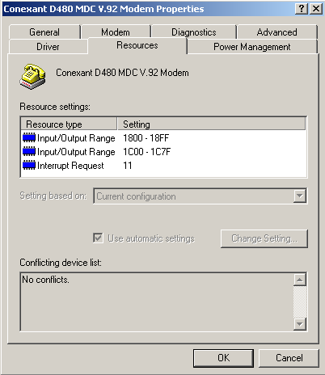
All modern computers have Interrupt Request lines (IRQs) to help prioritise calls from devices and peripherals.
There are usually 16 of these, numbered 0 – 15. Ideally each device should have it’s own IRQ.
It is easy to see which devices are using which IRQs. Windows usually sets up IRQ lines by default.

Slide 16
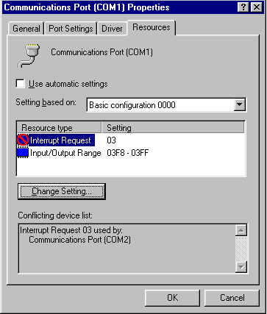
When installing a new peripheral, it may try to default onto an IRQ that is already being used by something else.
In this event the system will generate a Hardware Conflict. One, or both, of the devices may not work until this is manually resolved.

Slide 17
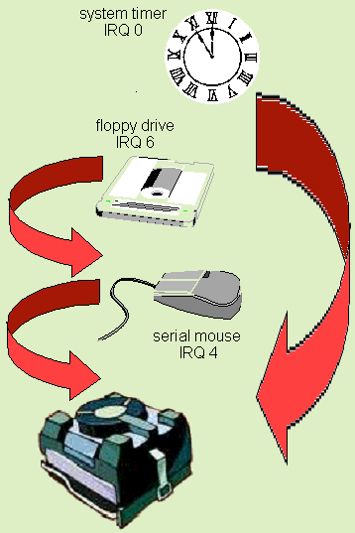
Generally speaking, the lower the IRQ number, the higher the priority. A device on a lower IRQ can interrupt a higher one and “steal” it’s place in the queue!
This is called a nested interrupt.
Peripherals that must be serviced within a specific time are assigned a non-maskable interrupt (NMI). These NMIs override all other interrupts.

Slide 18

However, the numbers don’t run in order!
There are never any devices on IRQ2.
Older computers only had 8 IRQ lines, and the demand for lines soon outstripped this as systems became more complicated.
IRQ2 then became a “cascade”, or a stepping stone to the higher 8 numbers.
So the order of priority is actually –
0, 1, 8, 9, 10, 11, 12, 13, 14, 15, 3, 4, 5, 6 and 7.

Slide 19
Interrupt Service Routine
When a device needs attention, the following Interrupt Handler is triggered.
Interrupt is raised
Current CPU instruction is completed
Contents of internal registers are stored on a stack
Control is transferred to the memory address of the ISR
ISR is run
Internal register contents are restored from the stack
Original process continues from where it left off

Slide 20
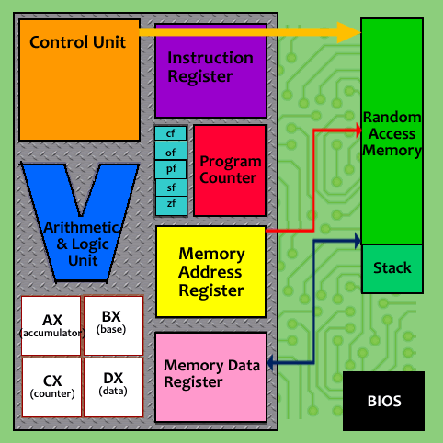
The Stack
The Stack is a special part of the RAM that is defined for particular purposes.
Whenever the CPU has to stop what it is doing to deal with an interrupt, all the values are dumped (pushed) on the stack.
When it resumes, the contents of the stack are restored (popped) to the registers and the CPU continues as normal.
What happens if the values to be stored are “too much” for the stack?

Slide 21
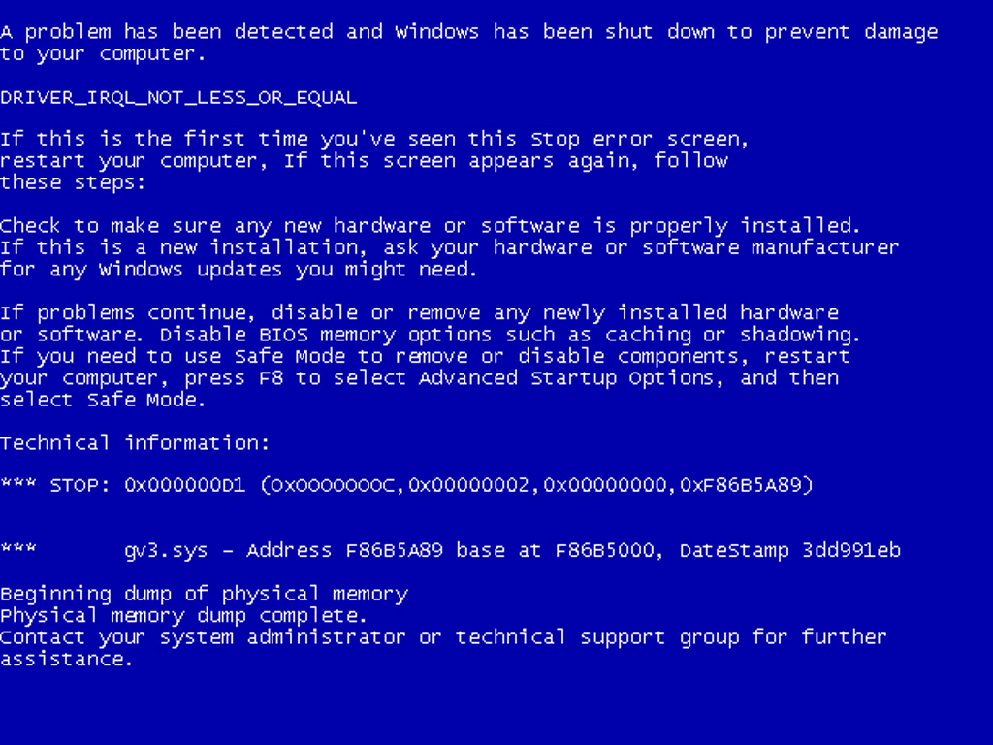

Slide 22
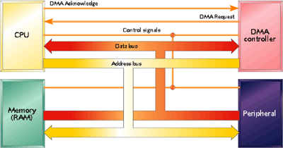
Direct Memory Access
DMA is a system whereby a data transfer is directly set up between a peripheral and RAM, which then runs without the data having to pass through the CPU.
The transfer is set up and controlled by a chip on the motherboard called the DMAC.
Once the transfer has started, it completes much more quickly, and frees up the CPU to get on with other things.

Slide 23
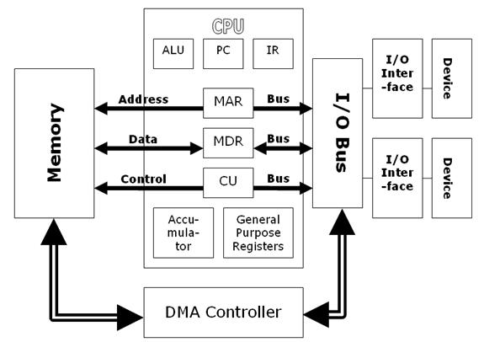
To set up a DMA transfer, the DMAC needs to know the memory start address, the amount of data to be transferred , the device involved and the direction of transfer (input or output).
The DMA controller then initiates the transfer, handing back control of the RAM and busses to the CPU on completion.

Slide 24

Limitations of DMA
DMA channels are useful for high speed transfers, but there is still only one bus system and one set of RAM available.
If both the CPU and DMAC require the RAM or bus, the DMAC takes priority.
This may cause the CPU to lose a memory access cycle, and so is known as cycle stealing.

Slide 25

Any Questions?

Slide 26

Summary
Peripherals communicate with the CPU by either Memory Mapped I/O or Dedicated I/O.
Interfaces incorporate a buffer, a control bit and a flag.
Devices also need their own dedicated drivers.
Devices are handled by either Polling or Interrupting.
A Polling architecture is cheap and simple to implement, but slow and wasteful in practice.
An Interrupt architecture is complex and expensive to implement, but very efficient.
Interrupts have to be prioritised and a system of IRQs is used.

Slide 27

Credits
Memory Mapped I/O and Dedicated I/O based on diagrams by Brussels Free University
Device Driver, IRQ screenshots © Microsoft
Confusion © clipart.com
Questions Monkey © MillionaireSecrets.com
Stack of Work © University of Pheonix online
All other graphics © Focus Multimedia with open licence, unless stated
All other contents © Aberdeen College 2010

